Slide 1

Lakbay Cycles
Power BI Analytics Solution
Analytics & Business Intelligence for Lakbay Cycles
Link to solution: https://github.com/anglegit/PowerBI
Confidential

Slide 2

Executive Introduction
Consolidate bicycle sales transactions and regional segments into a unified analytical model
Track sales velocity, product mix performance, and seasonal demand patterns across all bike categories and regions
Enable real-time monitoring of revenue trends, margin analysis, and customer lifetime value metrics for each product line
Automate weekly and monthly sales reporting pipelines, replacing manual spreadsheet consolidation across store locations
Using AdventureWorks dataset and split into different types of data sources
KEY OUTCOME
The Lakbay Cycles Power BI platform provides a centralized analytics layer that unifies sales transactions, regional snapshots, and time insights into a single source of truth—enabling stakeholders to monitor unit sales by bike category, identify slow-moving stock, analyze regional demand shifts, and measure customer retention and lifetime value in real time.

Slide 3

Current State Assessment
Reporting Landscape
Pain Points
Stakeholder Needs
Fragmented reports across multiple tools
Manual data consolidation processes
Inconsistent metrics and definitions
Slow time-to-insight for stakeholders
Data quality gaps and trust issues
Limited self-service capabilities
Real-time visibility into KPIs
Drill-down to transaction detail
Mobile-friendly access to dashboards

Slide 4

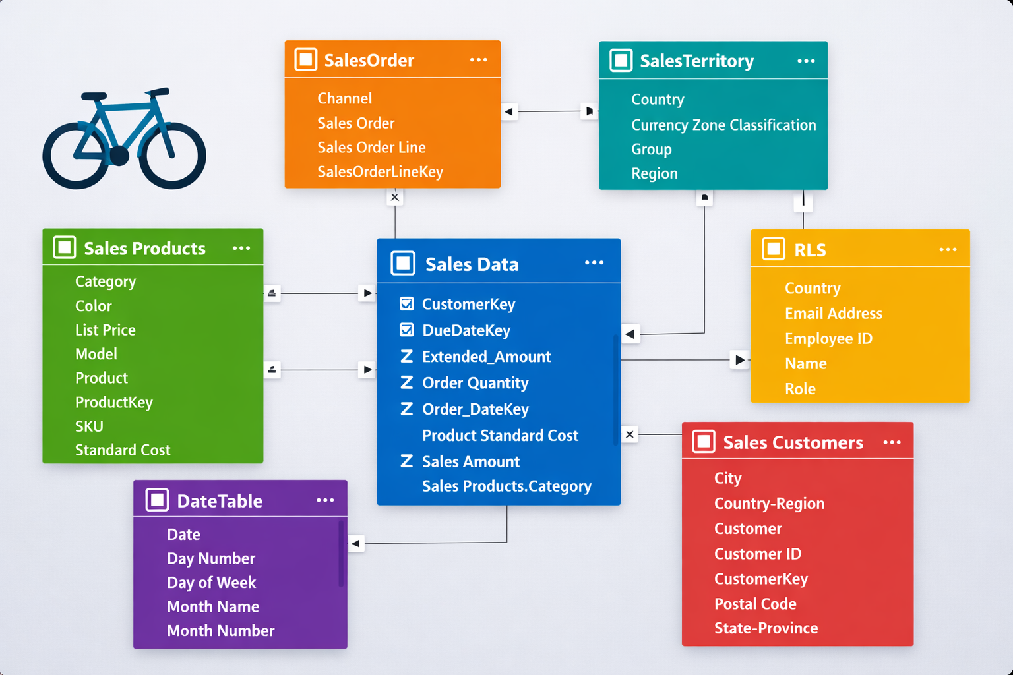
Data Model

Slide 5
Medallion Architecture
Layered data quality progression from raw ingestion to business-ready analytics
BRONZE
Raw Data Ingestion
SILVER
Cleaned & Conformed
GOLD
Business-Ready Analytics
Raw sales transaction logs from Excel data extract
Exact copy of source data, no transformations applied
Filtered data
  customerKey <> -1
  Year(OrderDateKey) < 2020
Corrected data types
Deduplicated and cleaned
Filtered, cleaned, and augmented for downstream use
Selected columns to use in the report
Filtered rows necessary for the report
Optimized for reporting, KPIs, and decision-making

Slide 6
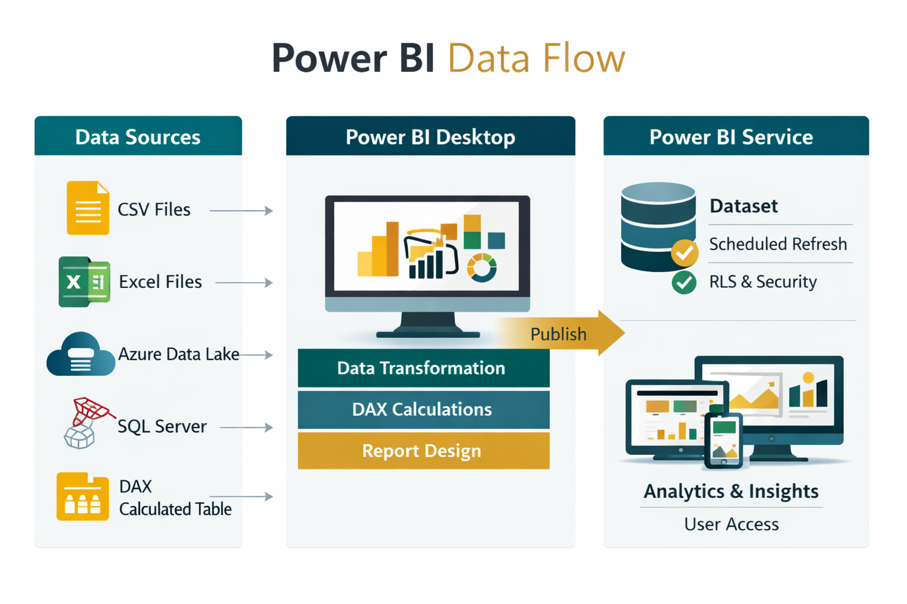
Data Flow

Slide 7




Documentation Foundation
Structured, governed, and traceable from requirements to delivery
Business Requirements
Document (BRD)
Functional Specification
Document (FSD)
Source-to-Target
Mapping Sheet
Business objectives & KPIs
User personas & use cases
Reporting scenarios
Success criteria
Dashboard features & interactions
Data transformations
KPI logic & definitions
Security requirements
Source systems & tables
Field-level mapping
Transformation rules
Data quality checks

Slide 8

Live Demo
Interactive Walkthrough of the Lakbay Cycles Solution
1. Executive Summary Walkthrough
2. Time Trends Exploration
3. Product Insights & Categories
4. Geographic Performance
5. Drill-Down & Self-Service
6. Transaction-Level Detail
7. Decision-Making Scenarios
8. Behind the Scenes (Optional)
9. Demo Close-Out & Summary
10. Q&A Discussion

Slide 9

User Experience & Navigation
Intuitive layout philosophy designed for rapid insight discovery
Consistent branding and visual themes across all dashboards
Standardized interaction patterns for filters, slicers, and navigation
Mobile-responsive layouts for on-the-go access
Bookmark and personalization features for frequent users
DESIGN PHILOSOPHY
Every dashboard follows a deliberate top‑down narrative structure designed for clarity and fast decision‑making. At the top, users see the KPIs — the headline numbers that instantly communicate performance. These metrics set the tone and frame the rest of the story. In the middle section, trend visuals provide context, showing how performance is moving over time and revealing patterns, shifts, or emerging issues. Finally, the drillthrough section presents the detailed data, giving users the ability to explore specifics, validate insights, and drill into operational layers. This structured flow ensures that anyone viewing the dashboard can move from insight to understanding to action in a smooth, intuitive sequence.

Slide 10

Security & Access
Data Security
Access Control
Governance
Row-level security (RLS)
Data sensitivity labels
Encryption at rest & in transit
Audit logging
Workspace role assignments
Group-based permissions
Service principal access
External sharing policies
Compliance guardrails
Data classification policies
Retention policies
Regular access reviews

Slide 11

Training & Enablement
Structured user onboarding program for all dashboard consumers
How to read and interpret dashboard visualizations effectively
Hands-on training for filters, drilldowns, and cross-filtering
Self-service analytics guidelines for power users
Ongoing learning resources and knowledge base access
TRAINING APPROACH
Role-based training paths ensure executives, analysts, and operational users each get relevant skills.

Slide 12

Support & Maintenance
Monitoring
Issue Resolution
Continuous Improvement
Automated refresh monitoring
Performance dashboards
Usage analytics tracking
Proactive alerting
Tiered support model
Data issue triage process
Root cause analysis
SLA expectations & tracking
Enhancement backlog
User feedback collection
Quarterly review cadence
Feature prioritization

Slide 13
Work Estimate by Workstream
Data & Modeling
Dashboard Development
Security, Testing & Go-Live
Data modeling & star schema: 3–4 weeks
ETL/ELT pipeline development: 3–4 weeks
Source-to-target mapping: 2 weeks
Executive dashboard design: 2–3 weeks
Operational reports: 3–4 weeks
Self-service & drill-down views: 2–3 weeks
RLS & access configuration: 1–2 weeks
UAT & QA testing: 2 weeks
Deployment & training: 2–3 weeks

Slide 14
Project Timeline
Estimated total duration: 18–22 weeks from kickoff to production go-live
Weeks 1–3
Weeks 4–12
Weeks 13–16
Weeks 17–20
Discovery & Requirements
Build & Development
Testing & UAT
Go-Live & Training
Stakeholder interviews
BRD & FSD drafting
Source system analysis
KPI definition
Data model & ETL
Dashboard development
KPI implementation
Security configuration
QA validation
User acceptance testing
Performance tuning
Bug fixes & refinement
Production deployment
User training sessions
Knowledge transfer
Hypercare support

Slide 15
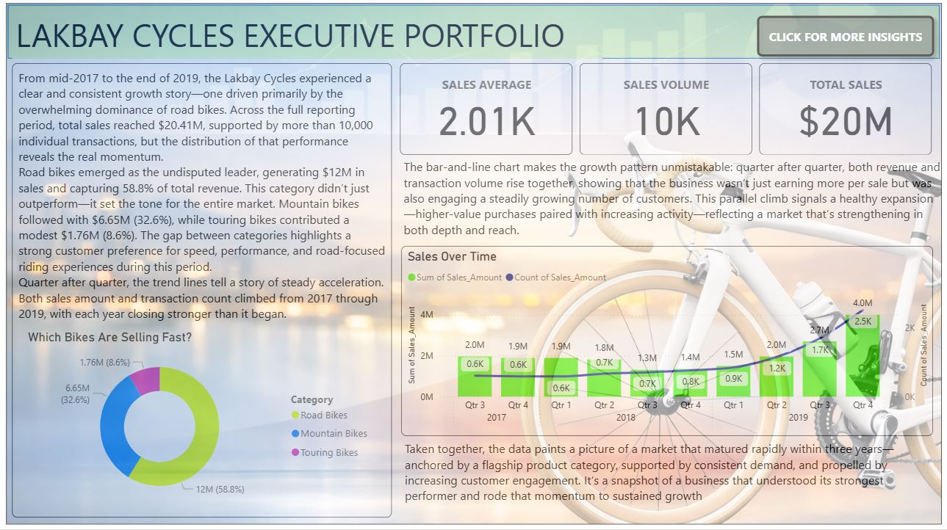

Slide 16
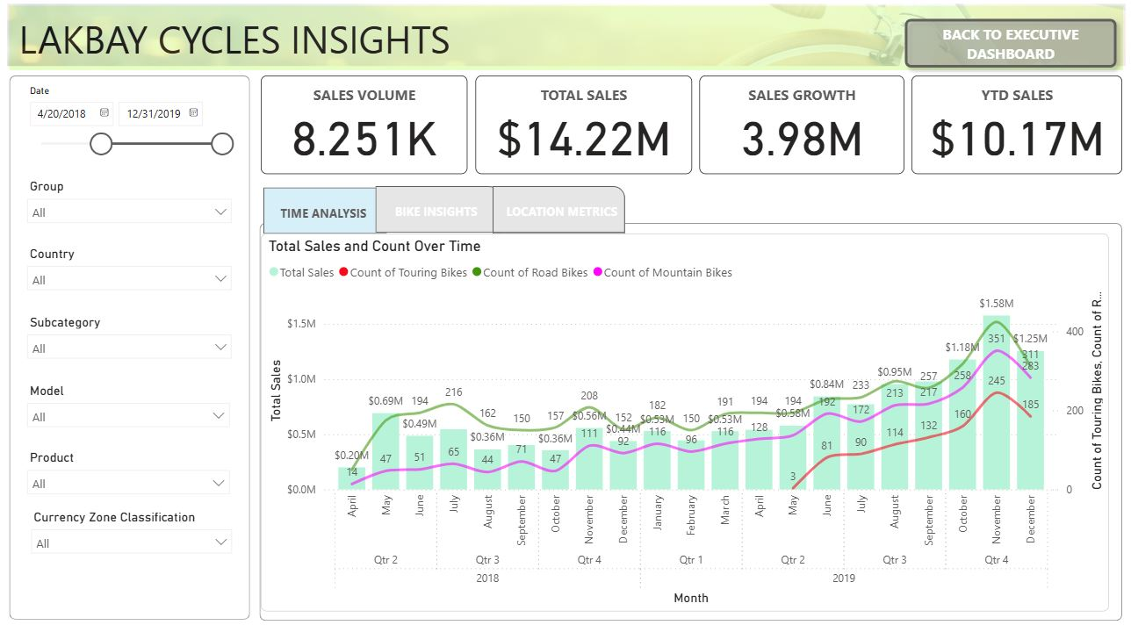

Slide 17
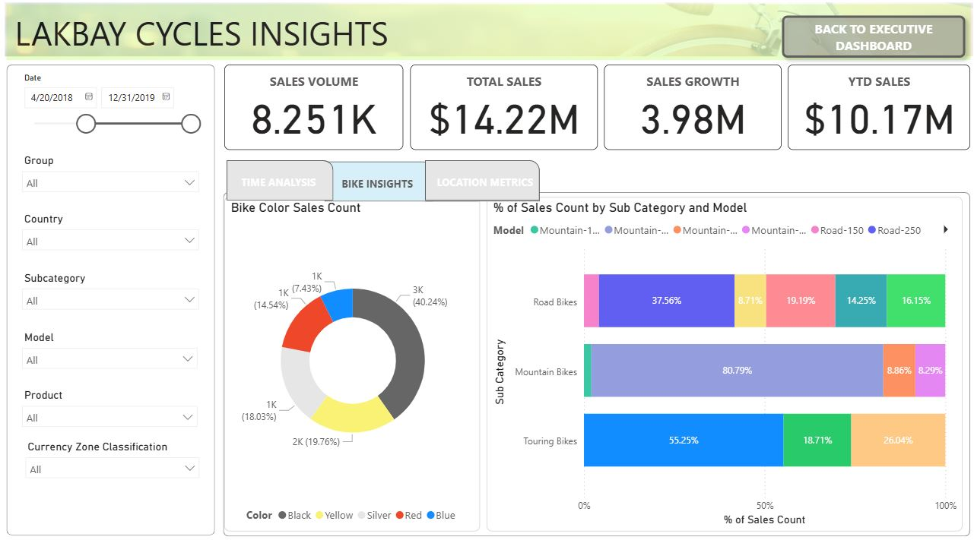

Slide 18
Closing Summary
Benefits Delivered
Business Impact
Next Steps
Lakbay Cycles Power BI platform
Faster time-to-insight
Reduced manual effort
Data-driven decisions
Improved performance
Strategic agility
Timeline confirmation
Resource alignment
Kickoff planning
Thank You | Questions?

